Slide 1
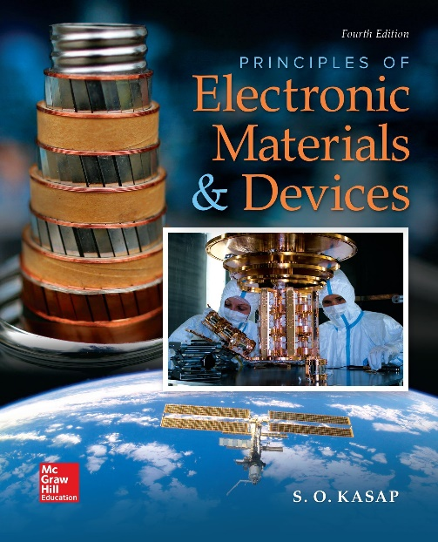
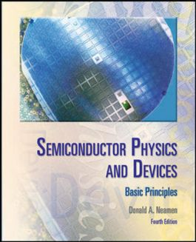

ELECTRONIC MATERIALS AND DEVICES
L | T | P | J | C
3 | 0 | 0 | 0 | 3
Dr. M. Saranya Nair
School of Electronics Engineering
VIT-Chennai Campus
E-mail : saranyanair.m@vit.ac.in
MODULE 3

Slide 2
ELECTRONIC MATERIALS AND DEVICES
MODULE 3
Carrier Transport Mechanism
Charge carriers in semiconductors – Drift and Diffusion of carriers – Mobility – Generation, Recombination and injection of carriers – Carrier transport equations – Excess carrier lifetime.

Slide 3
Carrier Transport Phenomena in Semiconductors
The process by which the charged particles move is called transport.
Two basic transport mechanisms in a semiconductor crystal:
Drift - the movement of charge due to electric fields, and
Diffusion - the flow of charge due to density gradients.
The carrier transport phenomena are the foundation for finally determining the current–voltage characteristics of semiconductor devices.

Slide 4
CARRIER DRIFT
An electric field applied to a semiconductor will produce a force on electrons / holes so that they will experience a net acceleration and net movement. This net movement of charge due to an electric field is called drift. The net drift of charge gives rise to a drift current.
If we have a positive volume charge density moving at an average drift velocity v_{d}, the drift current density is given by
If the volume charge density is due to positively charged holes, then

Slide 5
CARRIER DRIFT
If the volume charge density is due to electrons, then

Slide 6
CARRIER DRIFT
The conventional drift current due to electrons is also in the same direction as the applied electric field even though the electron movement is in the opposite direction.
Electron and hole mobilities are also functions of temperature and doping concentrations.
Since both electrons and holes contribute to the drift current, the total drift current density is the sum of the individual electron and hole drift current densities

Slide 7
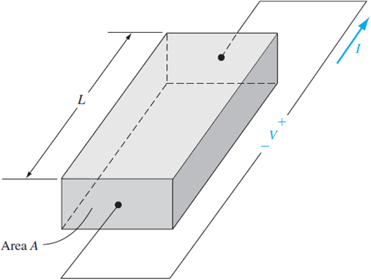
Conductivity
If we have a bar of semiconductor material as shown in Figure with a voltage applied that produces a current I, then we can write J = I /A and E = V /L

Slide 8
CARRIER DIFFUSION
There is a second mechanism, in addition to drift, that can induce a current in a semiconductor.
Diffusion is the process whereby particles flow from a region of high concentration toward a region of low concentration.
If the particles were electrically charged, the net flow of charge would result in a diffusion current.

Slide 9
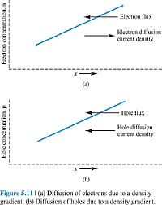
Diffusion Current Density
The diffusion of electrons from a region of high concentration to a region of low concentration produces a flux of electrons flowing in the negative x direction for this example. Since electrons have a negative charge, the conventional current direction is in the positive x direction.
D_{n} is called the electron diffusion coefficient, has units of cm²/s, and is a positive quantity.

Slide 10
The diffusion of holes, from a region of high concentration to a region of low concentration, produces a flux of holes in the negative x direction.
Since holes are positively charged particles, the conventional diffusion current density is also in the negative x direction.
The diffusion coefficient and mobility are not independent parameters. The relation between the mobility and diffusion coefficient, is known as the Einstein relation.

Slide 11
Calculate the diffusion current density given a density gradient. Assume that, in an n-type gallium arsenide semiconductor at T = 300 K, the electron concentration varies linearly from 1 x 10¹⁸ to 7 x 10¹⁷ cm⁻³ over a distance of 0.10 cm. Calculate the diffusion current density if the electron diffusion coefficient is Dn = 225 cm²/s.
108 A /cm2

Slide 12
Calculate the drift current density in a semiconductor for a given electric field. Consider a gallium arsenide sample at T = 300 K with doping concentrations of Na = 0 and Nd = 10¹⁶ /cm³. Assume electron and hole mobilities given as 8500 & 400 (cm²/V-s). Calculate the drift current density if the applied electric field is E = 10 V/cm.
136 A /cm2

Slide 13
Mobility Effects
Mobility, relates the average drift velocity of a carrier to the electric field.
Electron and hole mobilities are important semiconductor parameters in the characterization of carrier drift.
It describes how well a particle will move due to an electric field. The unit of mobility is usually expressed in terms of cm² /V-s.
The equation of motion of a positively charged hole in the presence of an electric field is

Slide 14
If we assume that the effective mass and electric field are constants,
The charged particles in a semiconductor are involved in collisions which alter the velocity characteristics of the particle.
As the hole accelerates in a crystal due to the electric field, the velocity increases. When the charged particle collides with an atom in the crystal, the particle loses most, or all, of its energy. The particle will again begin to accelerate and gain energy until it is again involved in a scattering process. This continues over and over again. Throughout this process, the particle will gain an average drift velocity which is directly proportional to the electric field. There is a mean time between collisions which may be denoted by τ_{cp}.
Typical random behavior of a hole in a semiconductor (a) without an
electric field and (b) with an electric field.

Slide 15
There are two collision or scattering mechanisms that dominate in a semiconductor and affect the carrier mobility: phonon or lattice scattering, and ionized impurity scattering.
The atoms in a semiconductor crystal have a certain amount of thermal energy at temperatures above absolute zero that causes the atoms to randomly vibrate about their lattice position within the crystal. The lattice / thermal vibrations cause a disruption of the potential function, resulting in an interaction between the electrons or holes and the vibrating lattice atoms. This lattice scattering is also referred to as phonon scattering.

Slide 16
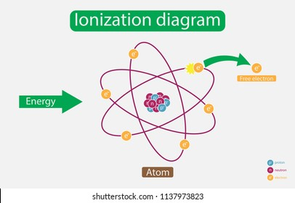
Since lattice scattering is related to the thermal motion of atoms, the rate at which the scattering occurs is a function of temperature. Mobility that is due to lattice scattering decreases as the temperature increases.
The second interaction mechanism affecting carrier mobility is called ionized impurity scattering. Impurity atoms are added to the semiconductor to control or alter its characteristics. These impurities are ionized at room temperature so that a coulomb interaction exists between the electrons or holes and the ionized impurities. This coulomb interaction alters the velocity characteristics of the charge carrier.
If temperature increases, the random thermal velocity of a carrier increases, reducing the time the carrier spends in the vicinity of the ionized impurity center. The less time spent in the vicinity of a coulomb force, the smaller the scattering effect. If the number of ionized impurity centers increases, then the probability of a carrier encountering an ionized impurity center increases, implying a smaller value of I.

Slide 17
CARRIER GENERATION AND RECOMBINATION
Generation is the process whereby electrons and holes are created, and recombination is the process whereby electrons and holes are annihilated.
Any deviation from thermal equilibrium will tend to change the electron and hole concentrations in a semiconductor.
A sudden increase in temperature, for example, will increase the rate at which electrons and holes are thermally generated so that their concentrations will change with time until new equilibrium values are reached.
An external excitation, such as light (a flux of photons), can also generate electrons and holes, creating a non equilibrium condition.

Slide 18
The Semiconductor in Equilibrium
In thermal equilibrium, these concentrations are independent of time. However, electrons are continually being thermally excited from the valence band into the conduction band by the random nature of the thermal process. At the same time, electrons moving randomly through the crystal in the conduction band may come in close proximity to holes and “fall” into the empty states in the valence band. This recombination process annihilates both the electron and hole.
Since the net carrier concentrations are independent of time in thermal equilibrium, the rate at which electrons and holes are generated and the rate at which they recombine must be equal.

Slide 20
Excess Carrier Generation and Recombination
Electrons in the valence band may be excited into the conduction band when, for example, high-energy photons are incident on a semiconductor.
When this happens, not only is an electron created in the conduction band, but a hole is created in the valence band; thus, an electron–hole pair is generated. The additional electrons and holes created are called excess electrons and excess holes.

Slide 21
Low-level injection puts limits on the magnitude of the excess carrier concentration compared with the thermal-equilibrium carrier concentrations.
In an extrinsic n-type material, we generally have n0 > p0 and, in an extrinsic p-type material, we generally have p0 > n0.
Low-level injection means that the excess carrier concentration is much less than the thermal-equilibrium majority carrier concentration.
Conversely, high-level injection occurs when the excess carrier concentration becomes comparable to or greater than the thermal-equilibrium majority carrier concentrations.

Slide 23
where τ is a constant for the low-level injection, describes the decay of excess minority carrier electrons so that, is often referred to as the excess minority carrier lifetime

Slide 25
GRADED IMPURITY DISTRIBUTION
Consider a semiconductor that is non uniformly doped with donor impurity atoms.
There will be a diffusion of majority carrier electrons from the region of high concentration to the region of low concentration.
The flow of negative electrons leaves behind positively charged donor ions. The separation of positive and negative charge induces an electric field that is in a direction to oppose the diffusion process.

Slide 26
Module III Mathematical Relations for Problems

